Slide 1

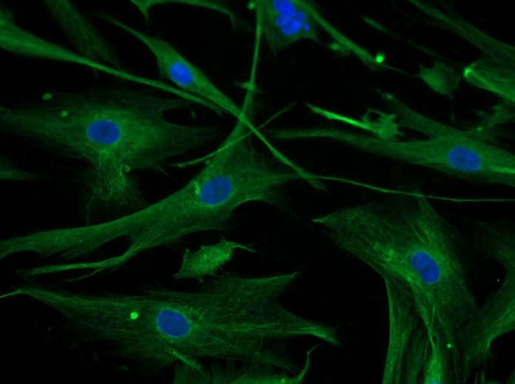
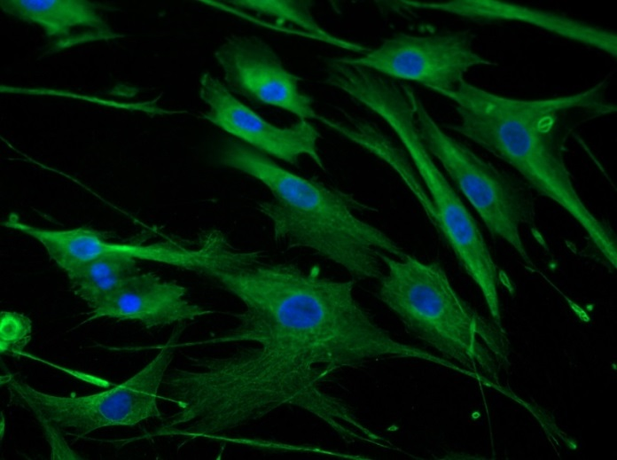
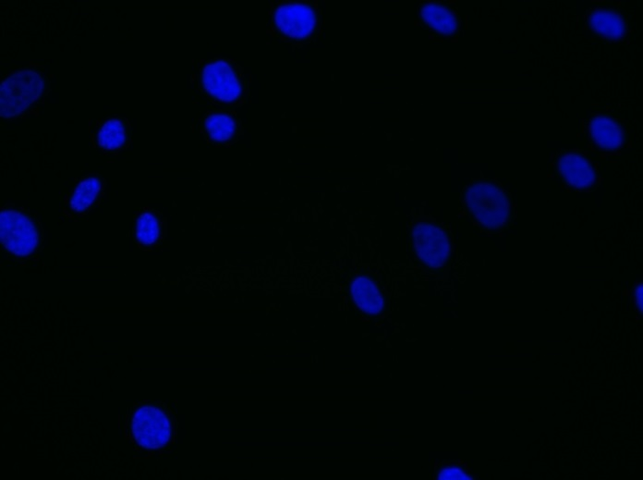
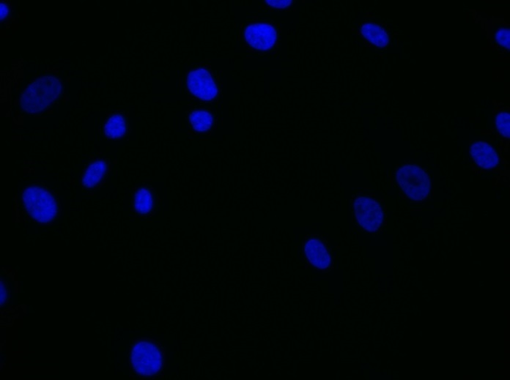
Reliatech GmbH
Mouse anti-human VEGF-A
(Cat# 101-M58 [10 µg/ml]; NHDF)
Immunofluorescence staining of human VEGF-A (#101-M58) in primary normal human fibroblasts (NHDF) using a monoclonal antibody directed against human VEGF165.
As secondary antibody goat anti-mouse ALEXA Flour 488 (Dianova; 1:600) was used.
[IF_LEC1406-02]
.
mouse anti-human VEGF-A
mouse anti-human VEGF-A
Control (goat anti-mouse IgG ALEXA Flour 488; 1:600)
http://www.reliatech.de / orders@reliatech.de

